Slide 1
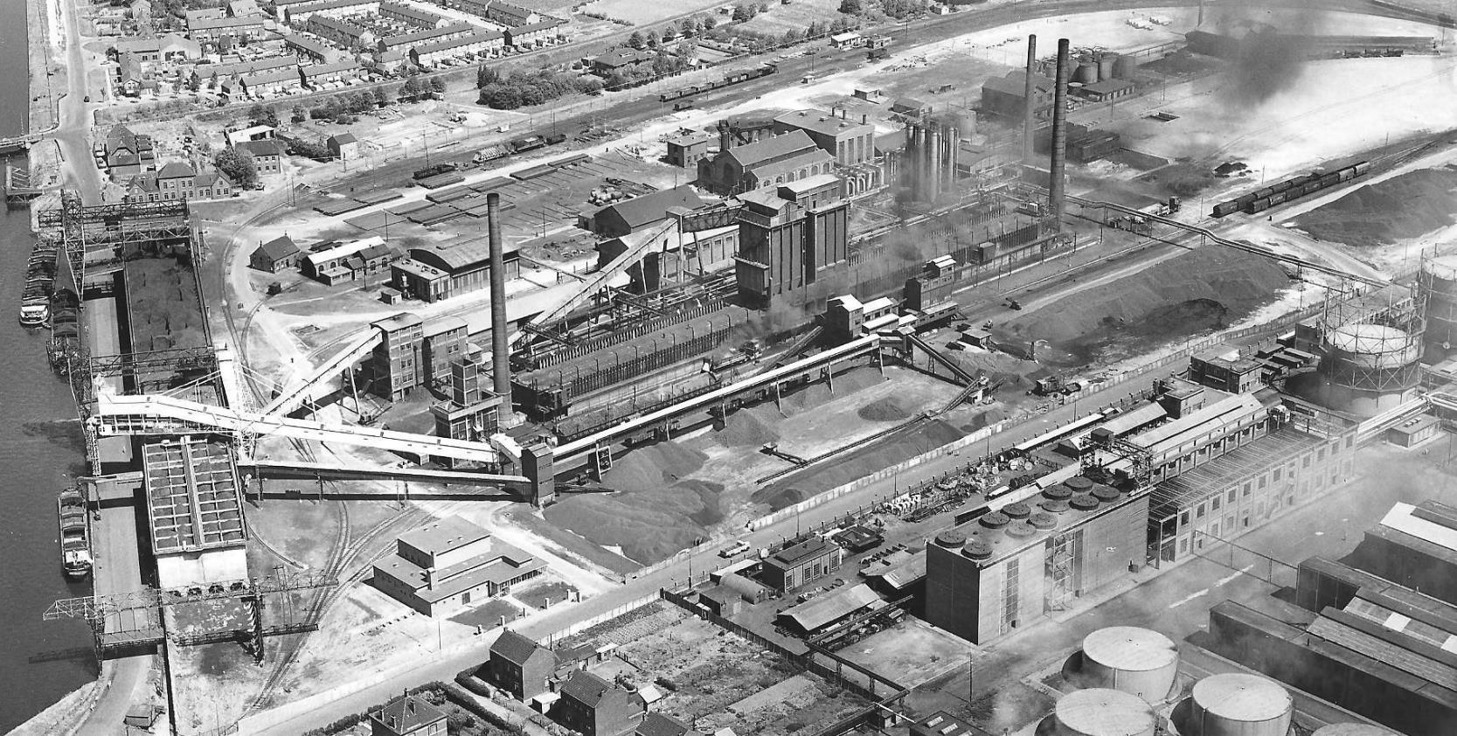
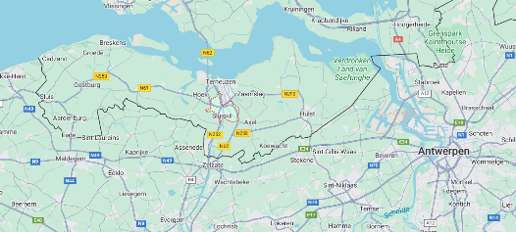

Wilco, Co-host GSF NL, Lead Dev / Architect @ HighTeh Innovators

Slide 2
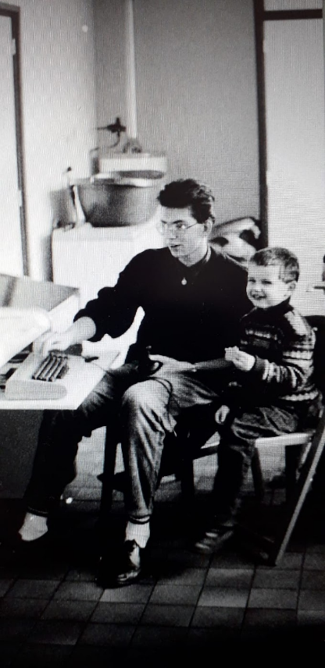

Coal to coke factory: The produced coke was utilized as a fuel and a reducing agent in blast furnaces to produce pig iron from iron ore.
WHY WAS IT CLOSED? * It is now a recycling plant

Slide 3
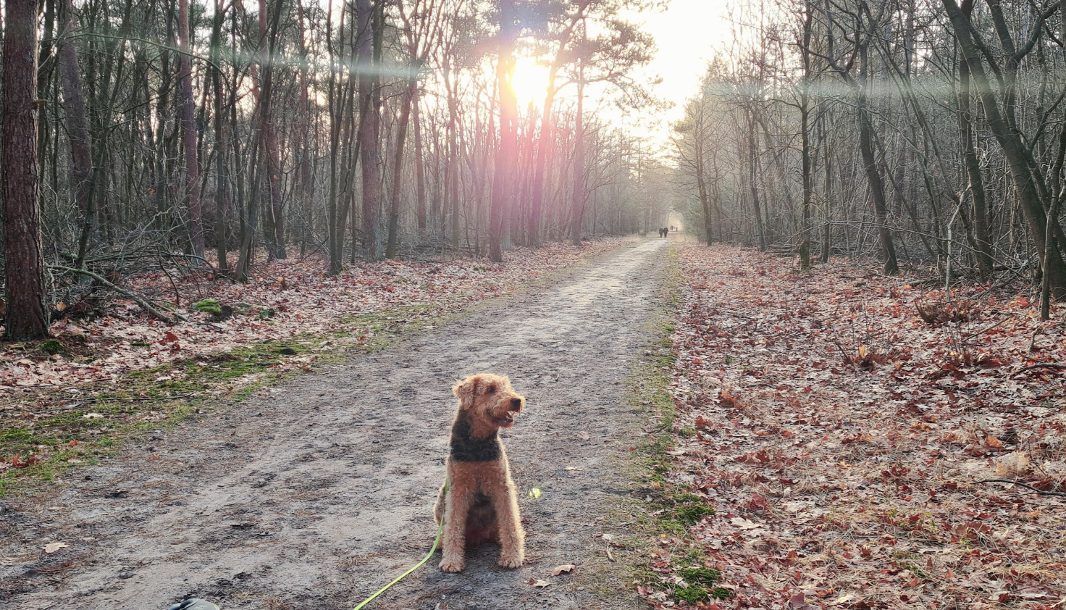
I have a passion for hiking
in the stunning landscapes of Noord-Brabant.

Slide 4

Raise your hand if...
This is ment as a interactive session. I hope all of you are eager to participate.

Slide 5
Let’s test your knowledge of Green IT ABCs— how well do you know them? 😄

Slide 6
Better understanding of how we function biologically enables greener device design—let's explore.

Slide 7
How much CO₂eq do humans emit per hour on average?

Slide 8
How much CO₂eq do humans emit per hour on average?
Answer: On average, a human emits approximately 900 grams of carbon dioxide equivalents (CO₂eq) per day through respiration. This translates to about 40 grams of CO₂eq per hour.
https://climate.mit.edu/ask-mit/does-carbon-dioxide-humans-breathe-out-contribute-climate-change

Slide 9
At how many kWh
does a human operate?

Slide 10
At how many kWh
does a human operate?
Answer: A human operates at about 0.1 kWh per hour at rest, roughly like a dim light bulb—brighter activities, like running, crank that up to 0.5 kWh or more!
https://www.elevationhealthsolutions.com/journey-to-optimal-health-blog/understanding-exercise-metrics-watts-mets-calories-and-more

Slide 11
What is the embodied carbon of a human including birth?

Slide 12
What is the embodied carbon of a human including birth?
Answer: The average embodied carbon of a human, including pregnancy and birth, is about 100 metric tons CO₂, covering emissions from prenatal care, delivery, food, housing, transportation, education, and caregiving through childhood to adulthood.
Estimation by ChatGPT

Slide 13
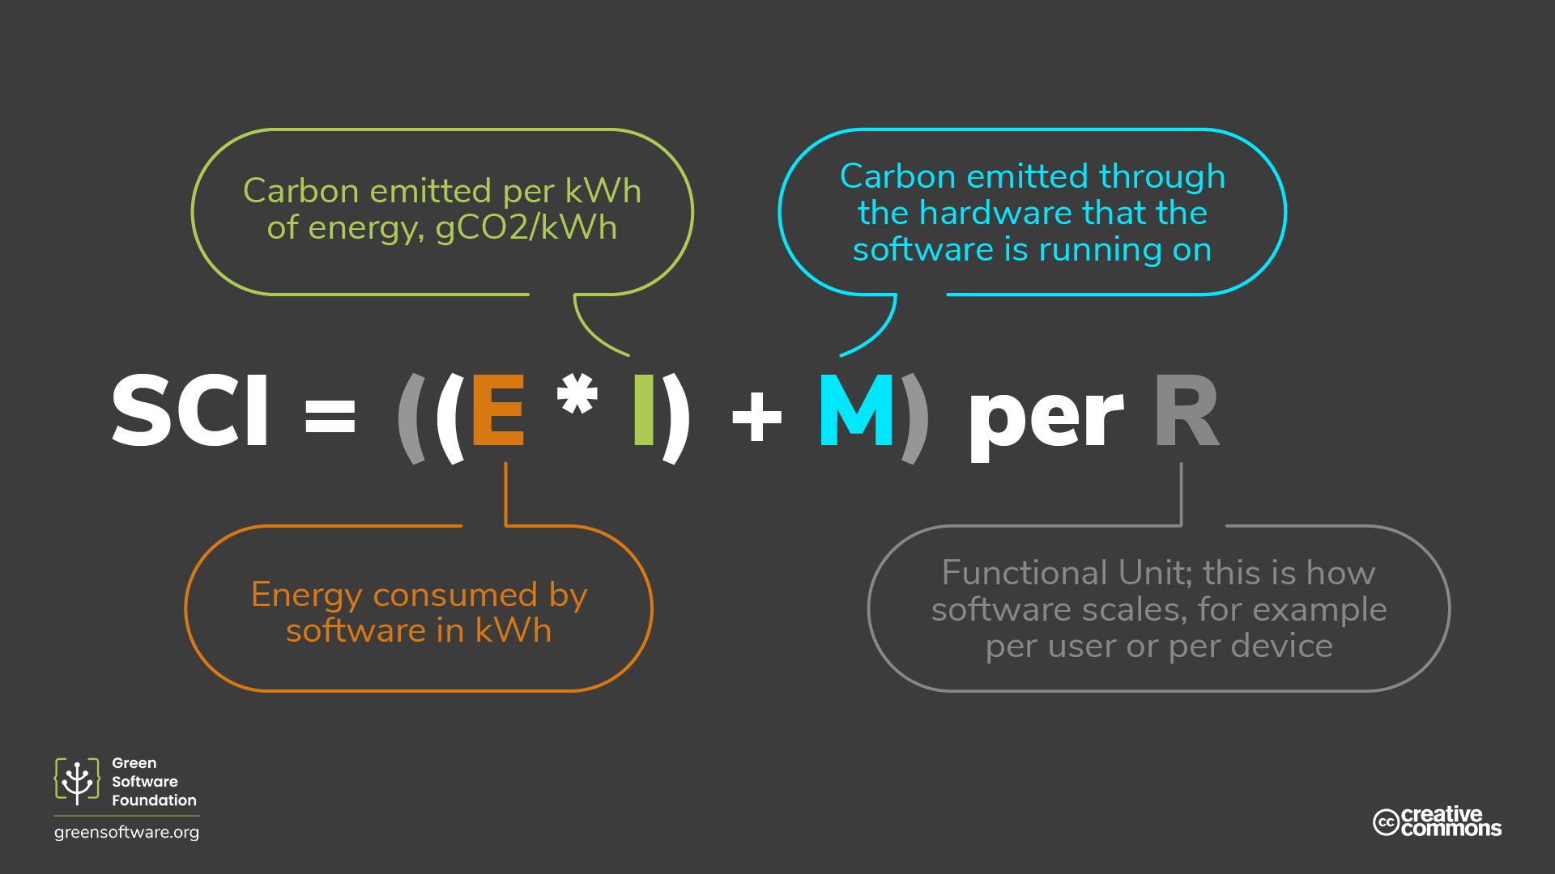

Slide 14
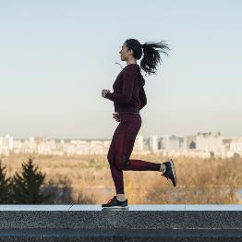
Run
15 Min

Slide 15

Run
0.5 kWh
15 Min

Slide 16
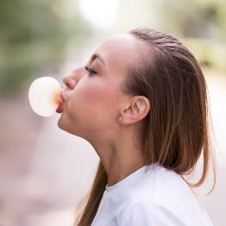
400 co2eq
Run
0.5 kWh
15 Min

Slide 17
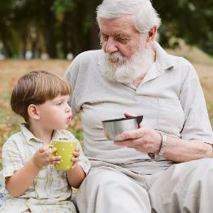
400 co2eq
100.000.000 co2eq
over 80 years
Run
0.5 kWh
15 Min

Slide 18
400 co2eq
100.000.000 co2eq
over 80 years
0.125
400
35
Run = 85 co2eq
0.5 kWh
15 Min

Slide 19
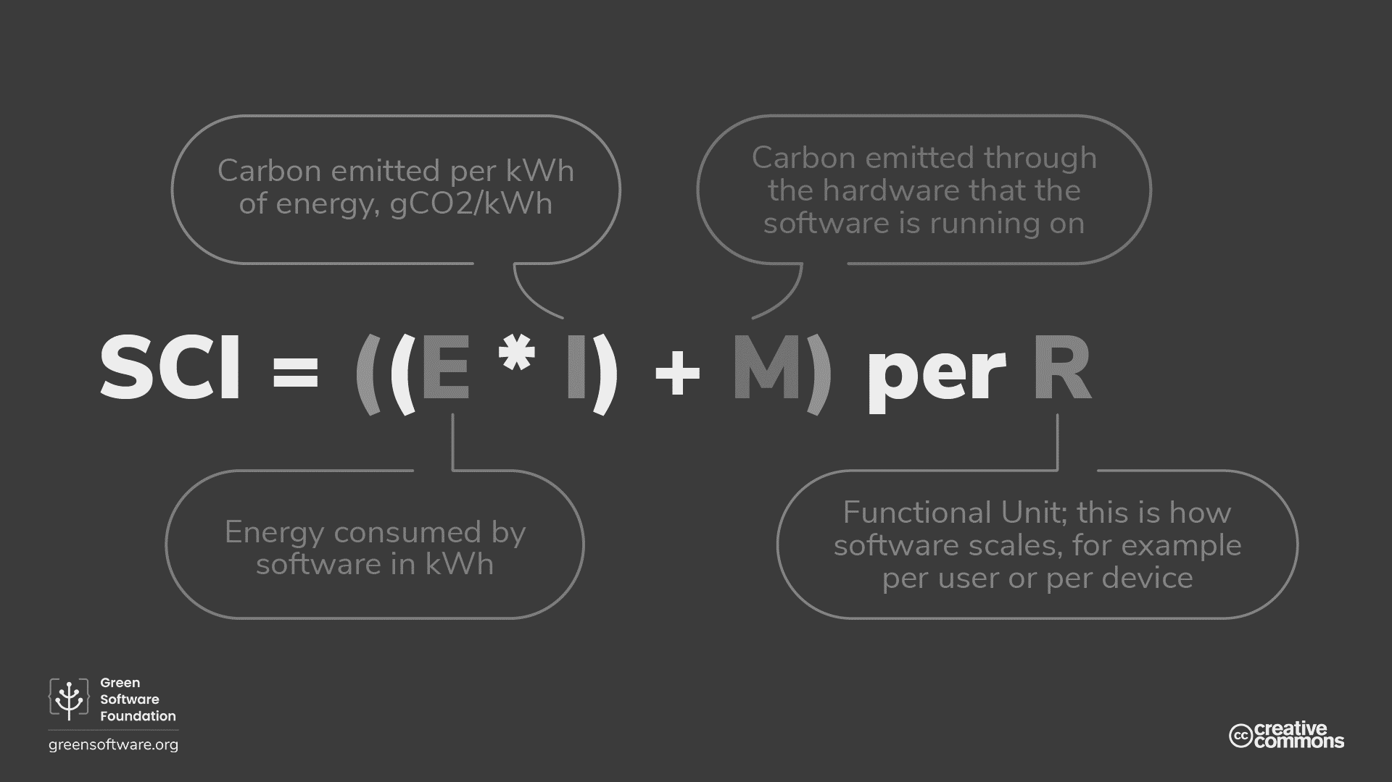
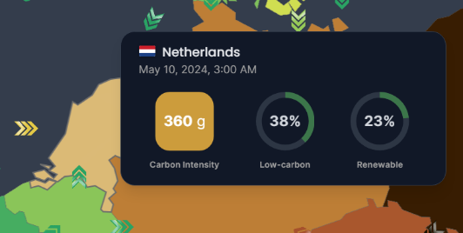
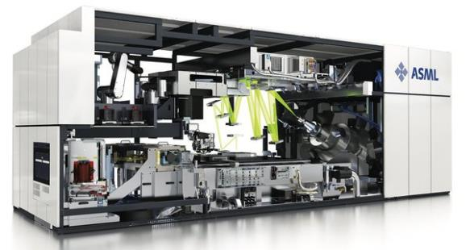


360 co2eq
Too Complex
0.35
360
1
Request = 127 co2eq
0.35 kWh
60 Min
350W

Slide 20
IMPACT
UNDERSTANDING

Slide 21
IMPACT
UNDERSTANDING
THE EFFECT THAT PEOPLE OR THINGS HAVE ON THE NATURAL WORLD
Let’s put it to the test!

Slide 22
Positive effect ||
Negative effect?
|| == OR shout out to the devs! #greencoders

Slide 23
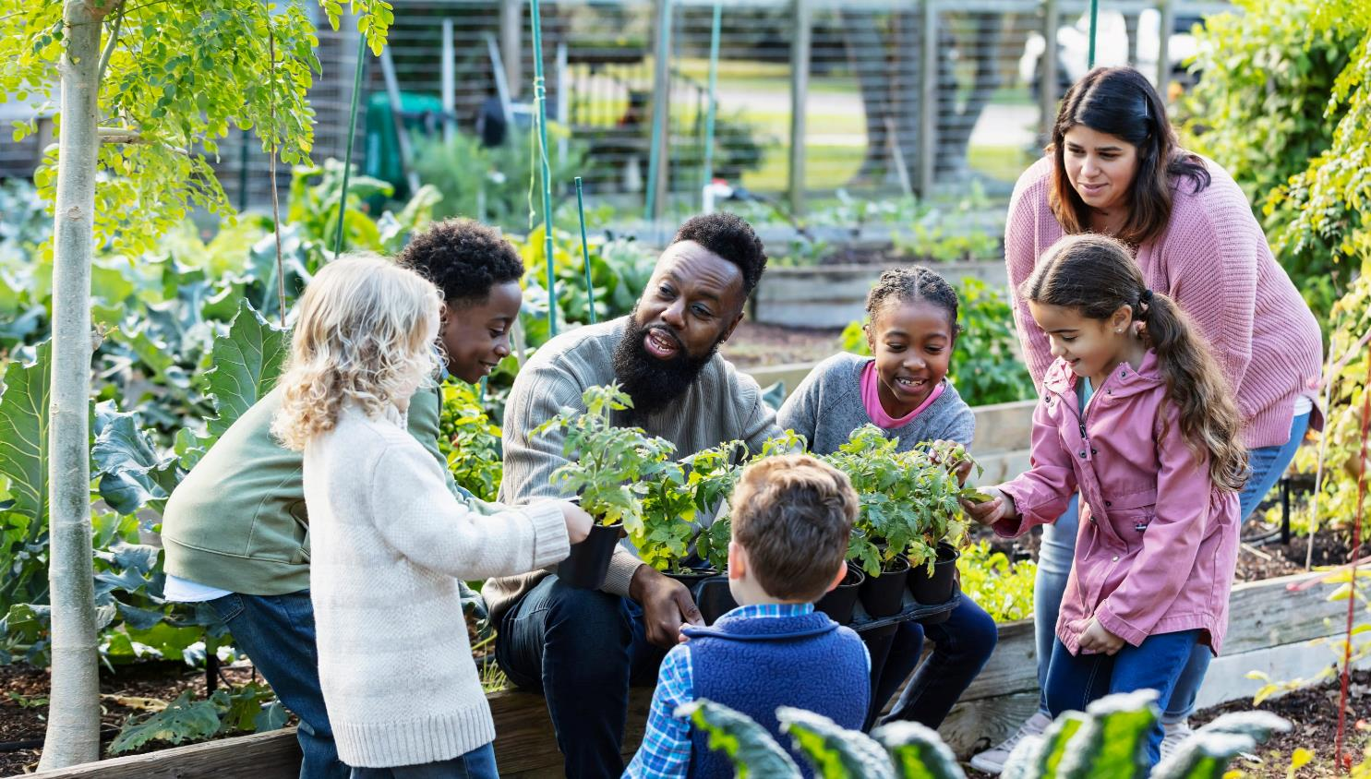
Community Gardens
Teaching
Socializing
Biodiversity
https://www.nourishingneighbors.com/

Slide 24
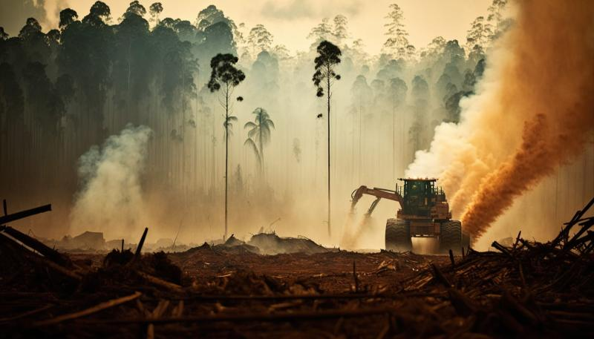
Deforestation
Actions
Consequences
Ecosystem
https://www.health.belgium.be/en/deforestation

Slide 25
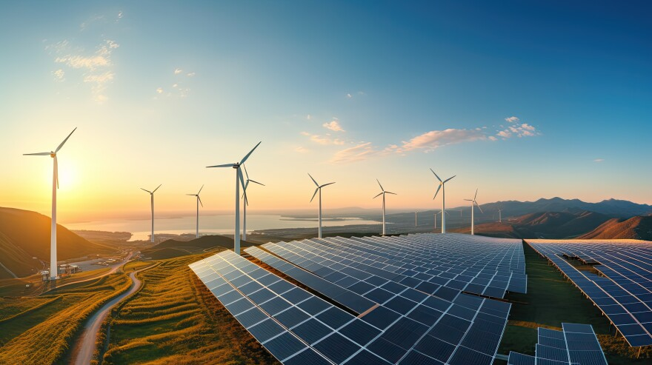
Renewable energy
Embodied Carbon
Operational Carbon Savings
Power Cost
https://www.wxpr.org/

Slide 26
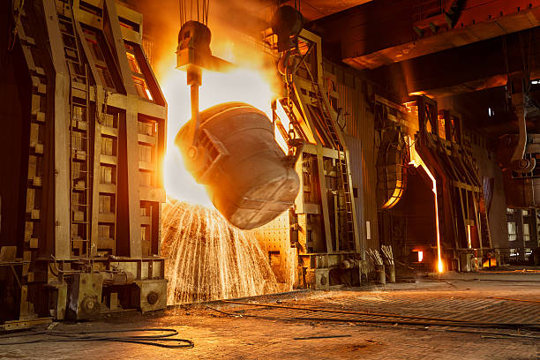
Metal smelting furnace in steel mills
Water
Emissions
Polution

Slide 27
var developerWisdom = new Hashtable
{{ 0, "Impact awareness" }};
shout out to the devs! #greencoders

Slide 28
IMPACT?
DOES SOFTWARE HAVE AN

Slide 29

BROWSER - TABS
No shaming, but who can relate to this picture?
Resource management

Slide 30
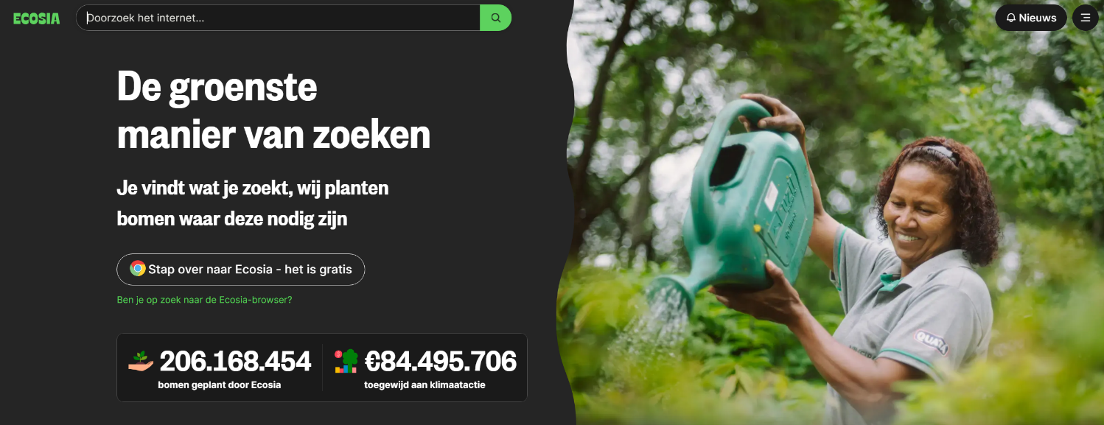
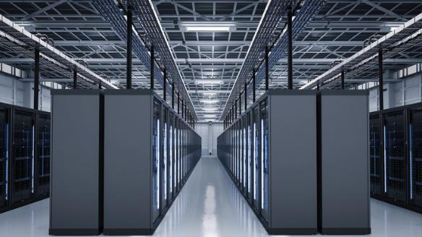
The illusion of a trillion trees https://ig.ft.com/one-trillion-trees/
= 0,0206%

Slide 31

Network Bandwith
Decoding
Brightness
Data usage & Compute
https://www.youtube.com/watch?app=desktop&v=t51rXwQk1zw

Slide 32
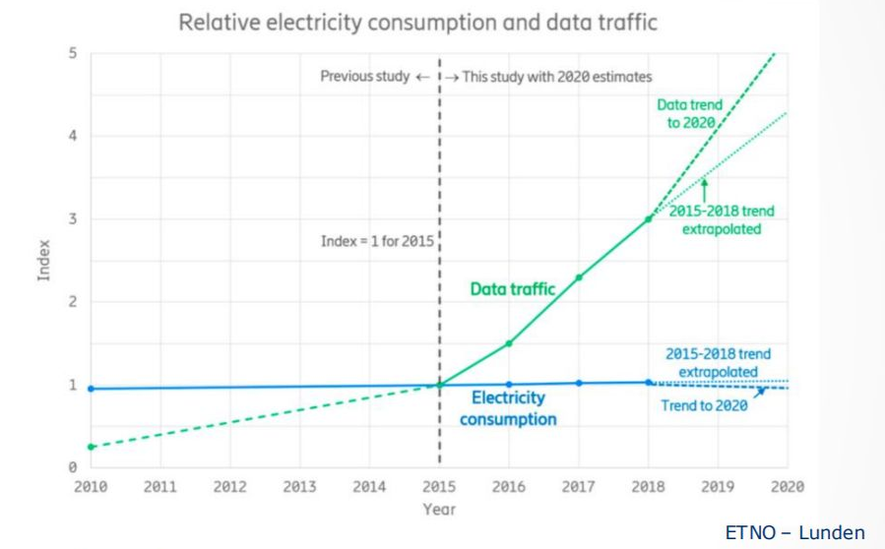
Network Bandwith
Decoding
Brightness
Data usage & Compute
https://www.youtube.com/watch?app=desktop&v=t51rXwQk1zw

Slide 33


Can you measure inference of Llama?

Slide 34
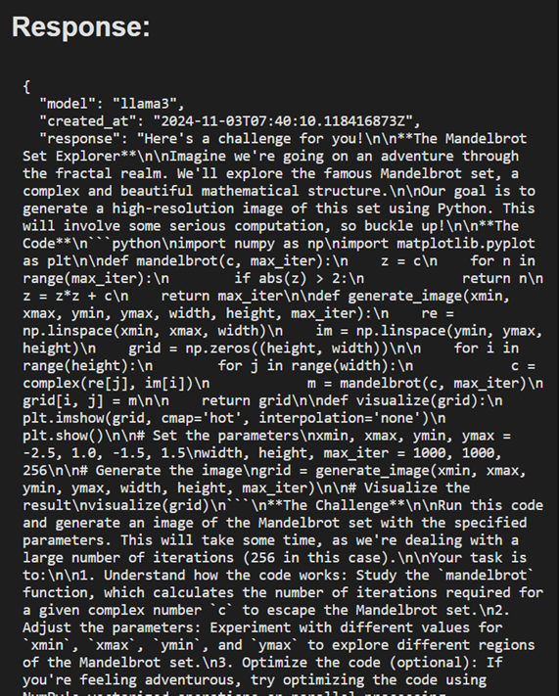
Can you measure inference of Llama?
©HighTech Innovators. All rights reserved.

Slide 35
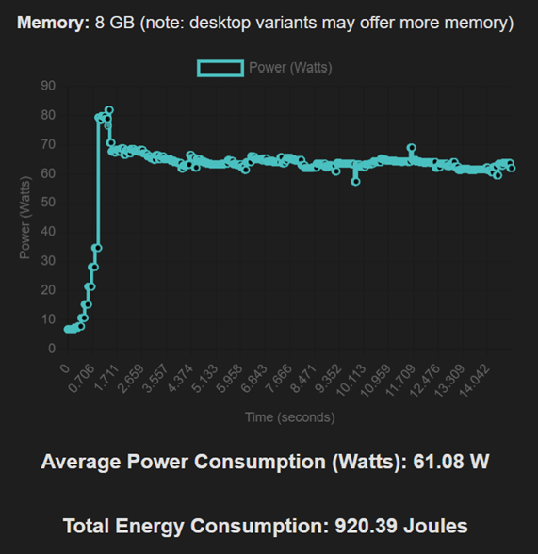
Can you measure inference of Llama?
©HighTech Innovators. All rights reserved.

Slide 36
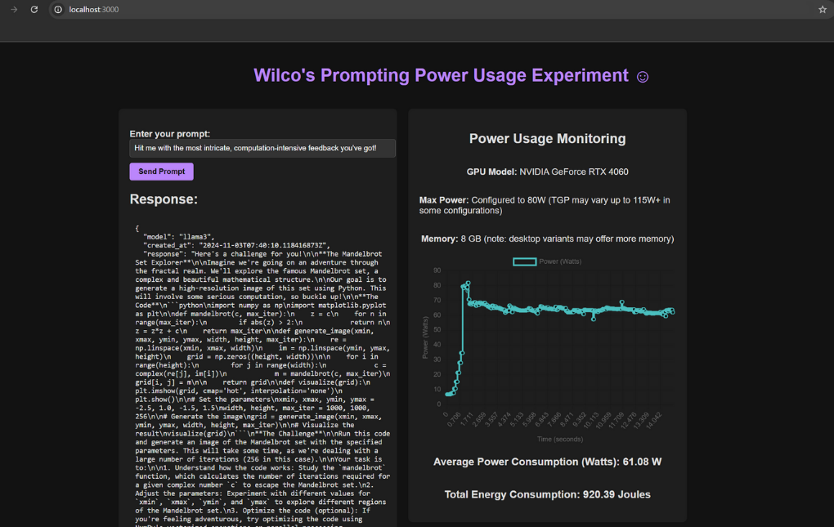
Can you measure inference of Llama?

Slide 37
QUESTIONS?
ANY

